Slide 1
Data Communication and Networking
Name : Amitendu Bikash Dhusiya
Roll No : 15242723010
Course : BCAC603
Subject : Networking

Slide 2
Introduction to Data Communication
Data communication is the exchange of data between two or more network devices.
It involves transmission of digital or analog data over a communication channel.
It is the basic foundation of computer networking.
Efficient data communication ensures reliable and fast information transfer.

Slide 3
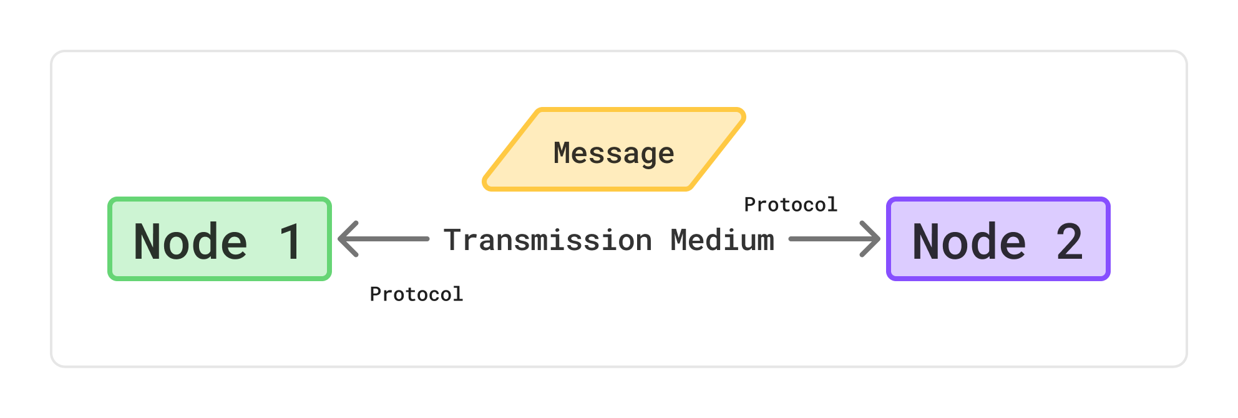
Components of Data Communication
Sender – Device that originates the data.
Receiver – Device that receives the data.
Message – Information to be transmitted.
Transmission Medium – Physical or wireless path for data.
Protocol – Set of rules for communication.

Slide 4
Modes of Communication
Simplex:
  One-way communication.
  Sender Sends Only and Receiver Only Receives. (Cannot be Reversed)
  Example: Keyboard to a PC.
Half Duplex:
  Two-way but one direction at a time
  Not at the Same time Only one can send data then the receiver can send data to the sender
  Example: Walkie-talkie.
Full Duplex:
  Two-way simultaneous communication
  Both can send data at the same time.
  Example: Telephone.

Slide 5
Fundamental Characteristics
Delivery – Data must reach the correct destination.
Accuracy – Data must be error-free.
Timeliness – Data must arrive on time.
Jitter – Variation in packet arrival time should be minimal.

Slide 6
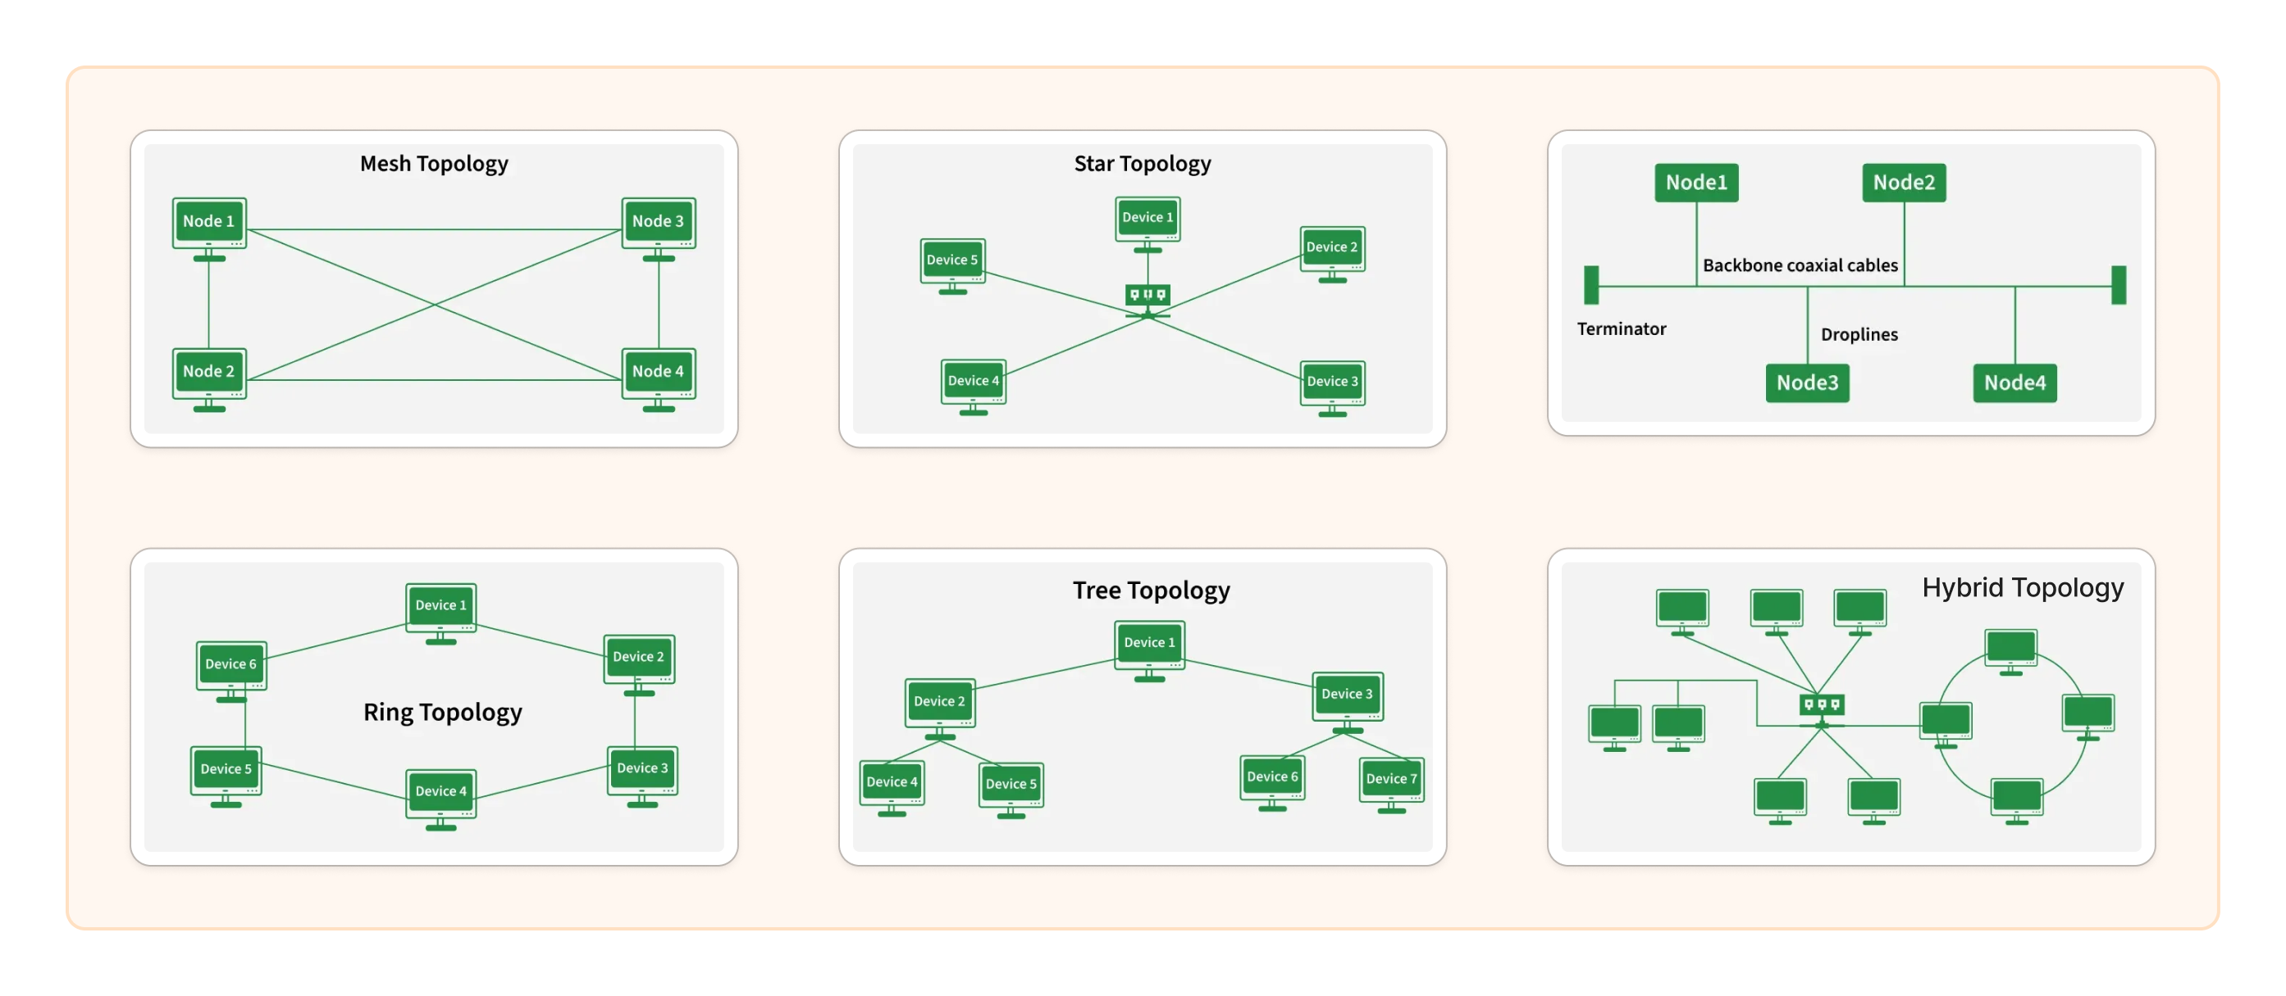
Physical Structure – Network Topology

Slide 7
THANKYOU

